Slide 1

Python
Tkinter CRUD
Presented by [Your Name Here]

Slide 2



Introduction to Tkinter and GUI Basics
Tkinter
Tkinter is Python's standard GUI toolkit.
GUI
GUI provides a visual interface for users.
User Interaction
GUI enhances user interaction with software applications.

Slide 3



Understanding CRUD Operations in Programming
Create
Adding new records to the database system
Read
Viewing and retrieving existing data records
Update
Modifying and changing existing data entries

Slide 4



Overview of the Student Management System
Manage Data
Efficiently organize and oversee student information easily.
Practical Learning
Hands-on experience with real-world database interaction.
User-Friendly Interface
Intuitive design enhances usability for all students.

Slide 5



Core Technologies for the Project
Python
Python is a versatile programming language used widely.
Tkinter
Tkinter is used for building graphical user interfaces.
MySQL
MySQL is a powerful relational database management system.

Slide 6
Database Setup
Essential SQL commands for creation
SQL Commands
To begin, you will need to create the database and the necessary table to store student information. Use the following SQL commands to accomplish these tasks successfully.

Slide 7
MySQL Connection
Connecting Python to MySQL Database
Establishing Connection
To connect Python with MySQL, you'll use the mysql.connector library. This allows for seamless database interactions, enabling you to perform CRUD operations effectively within your Tkinter application.

Slide 8

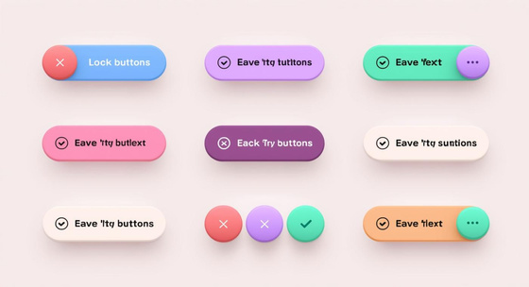

Key Components of GUI Design
Labels
Clearly identify fields for user input and interaction.
Buttons
Interactive elements that initiate actions and responses.
Layout
Organizes components for intuitive user navigation and clarity.

Slide 9
Add Operation
Inserting Data into Database
Insert Functionality
The insert operation allows users to add new records to the database efficiently. This functionality is essential for managing student information within the Student Management System.

Slide 10
Display Data
Understanding Treeview in Tkinter
Treeview Widget
The Treeview widget in Tkinter allows for displaying tabular data in a structured format. It provides a flexible way to visualize database records, enhancing user interaction and data management.

Slide 11
Update Operation
Selecting and modifying records
Update Functionality
The update operation enables users to select and change existing data in the database efficiently. This ensures that the information remains accurate and up-to-date for all users.

Slide 12
Delete Operation
Selecting and removing records efficiently
Deleting Records
The delete operation enables you to remove unwanted data from your database. This process involves selecting the specific record and executing a delete command to maintain data integrity.

Slide 13



Key Features of the Tkinter CRUD Application
User-Friendly
Simplified interactions enhance the user experience significantly.
Real-Time Connectivity
Instant updates ensure data reflects the latest changes.
Full CRUD Functionality
Comprehensive operations support all necessary data management tasks.

Slide 14



Common Issues in MySQL Connections
Connection Failure
Ensure the database server is running correctly.
Input Validation
Check for required fields before submission errors.
Server Issues
Make sure the server is accessible and functional.

Slide 15
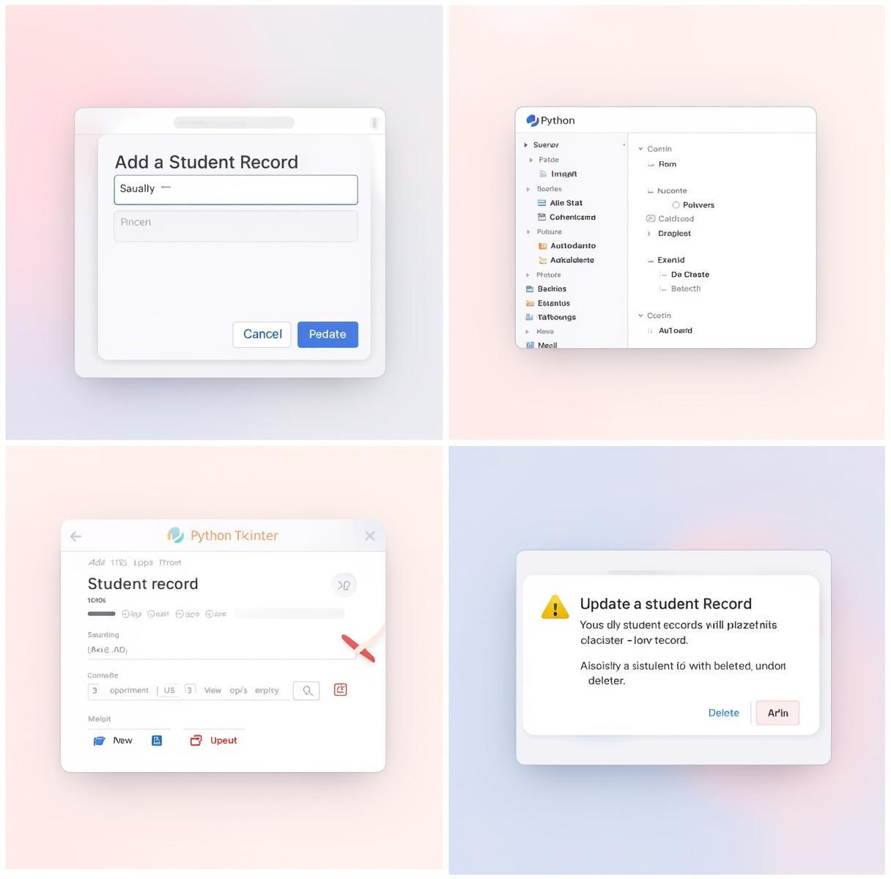
Application Demonstration
Key Functionalities
This section showcases the main features of the Student Management System, including adding, displaying, updating, and deleting student records through an intuitive GUI.

Slide 16
Conclusion
Key takeaways from the project
Understanding Tkinter
This project has provided a comprehensive understanding of Tkinter for GUI development and the implementation of CRUD operations with MySQL, enhancing Python programming skills with practical database interaction.

Slide 17

Thank You
We appreciate your attention and welcome your questions.
Phone: 123-456-7890
Email: hello@reallygreatsite.com
Website: reallygreatsite.com

